Slide 1

Data Integration and Large Scale Analysis 07 Cloud Computing Fundamentals
Slides Credit: Matthias Boehm
Last update: Nov 17, 2023

Slide 2
Announcement
Lectures on Tube
Exam date 02/02/2024 from 15:00 – 17:00
Registration will start from next week

Slide 3
Course Outline Part B: Large-Scale Data Management and Analysis
11 Distributed Stream Processing
12 Distributed Machine Learning Systems
10 Distributed Data-Parallel Computation
Compute/ Storage
09 Distributed Data Storage
08 Cloud Resource Management and Scheduling
Infra
07 Cloud Computing Fundamentals
Notes:
Note: collection of buzzwords → fundamentals and practical understanding

Slide 4
Agenda
Motivation and Terminology
Cloud Computing Service Models
Cloud, Fog, and Edge Computing

Slide 5
Motivation and Terminology

Slide 6
Motivation Cloud Computing
Motivation and Terminology
Definition Cloud Computing
On-demand, remote storage and compute resources, or services
User: computing as a utility (similar to energy, water, internet services)
Cloud provider: computation in data centers / multi-tenancy
Service Models
IaaS: Infrastructure as a service (e.g., storage/compute nodes)
PaaS: Platform as a service (e.g., distributed systems/frameworks)
SaaS: Software as a Service (e.g., email, databases, office, github)
➔ Transforming IT Industry/Landscape
Since ~2010 increasing move from on-prem to cloud resources
System software licenses become increasingly irrelevant
Few cloud providers dominate IaaS/PaaS/SaaS markets (w/ 2023 revenue): Microsoft Cloud ($ 111.6B), Amazon AWS ($ 88B), Google Cloud (8.41B), IBM Cloud ($ 20.8B), Oracle Cloud ($ 35.3B), Alibaba Cloud ($ 3,789M)

Slide 7
Motivation Cloud Computing, cont.
Motivation and Terminology
100%
Argument #1: Pay as you go
No upfront cost for infrastructure
Variable utilization ➔ over-provisioning
Pay per use or acquired resources
Argument #2: Economies of Scale
Purchasing and managing IT infrastructure at scale ➔ lower cost (applies to both HW resources and IT infrastructure/system experts)
Focus on scale-out on commodity HW over scale-up ➔ lower cost
Argument #3: Elasticity
Assuming perfect scalability, work done in constant time * resources
Given virtually unlimited resources allows to reduce time as necessary
Utili-zation
Time
100 days @ 1 node
≈
1 day @ 100 nodes (but beware Amdahl’s law: max speedup sp = 1/s)

Slide 8
Characteristics and Deployment Models
Motivation and Terminology
Extended Definition
ANSI recommended definitions for service types, characteristics, deployment models
Characteristics
On-demand self service: unilateral resource provision
Broad network access: network accessibility
Resource pooling: resource virtualization / multi-tenancy
Rapid elasticity: scale out/in on demand
Measured service: utilization monitoring/reporting
Deployment Models
Community cloud: single community (one or more orgs)
Private cloud: single org, on/off premises
Public cloud: general public, on premise of cloud provider
Hybrid cloud: combination of two or more of the above
[Peter Mell and Timothy Grance: The NIST Definition of Cloud Computing, NIST 2011]
MS Azure Private Cloud
IBM Cloud Private
Notes:
Notes characteristics: remotely available, pay as you go, shared infrastructure, high scalability

Slide 9
Cloud Computing Service Models (computing as a utility)
Notes:
TODO boris glavic

Slide 10
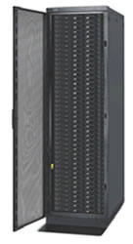
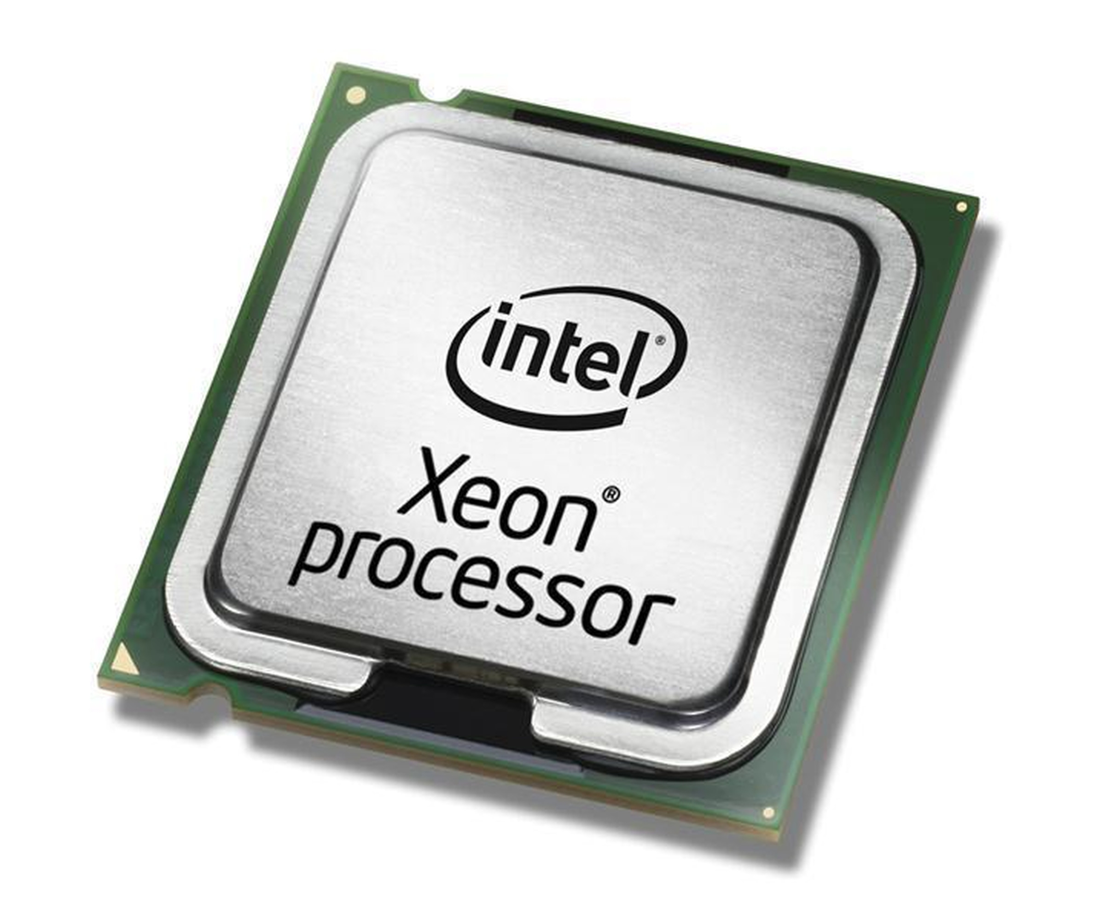
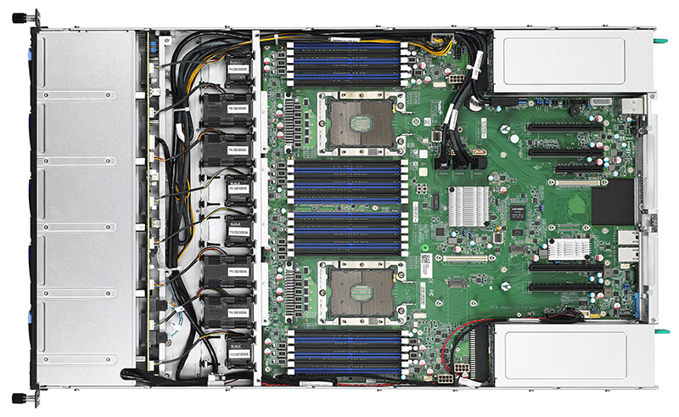
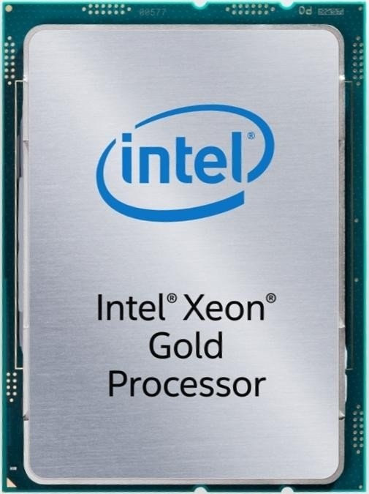
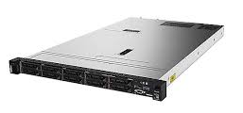
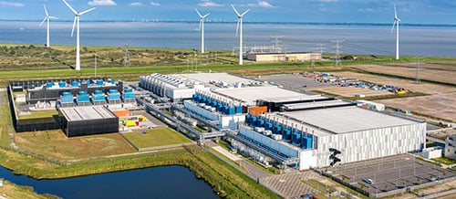
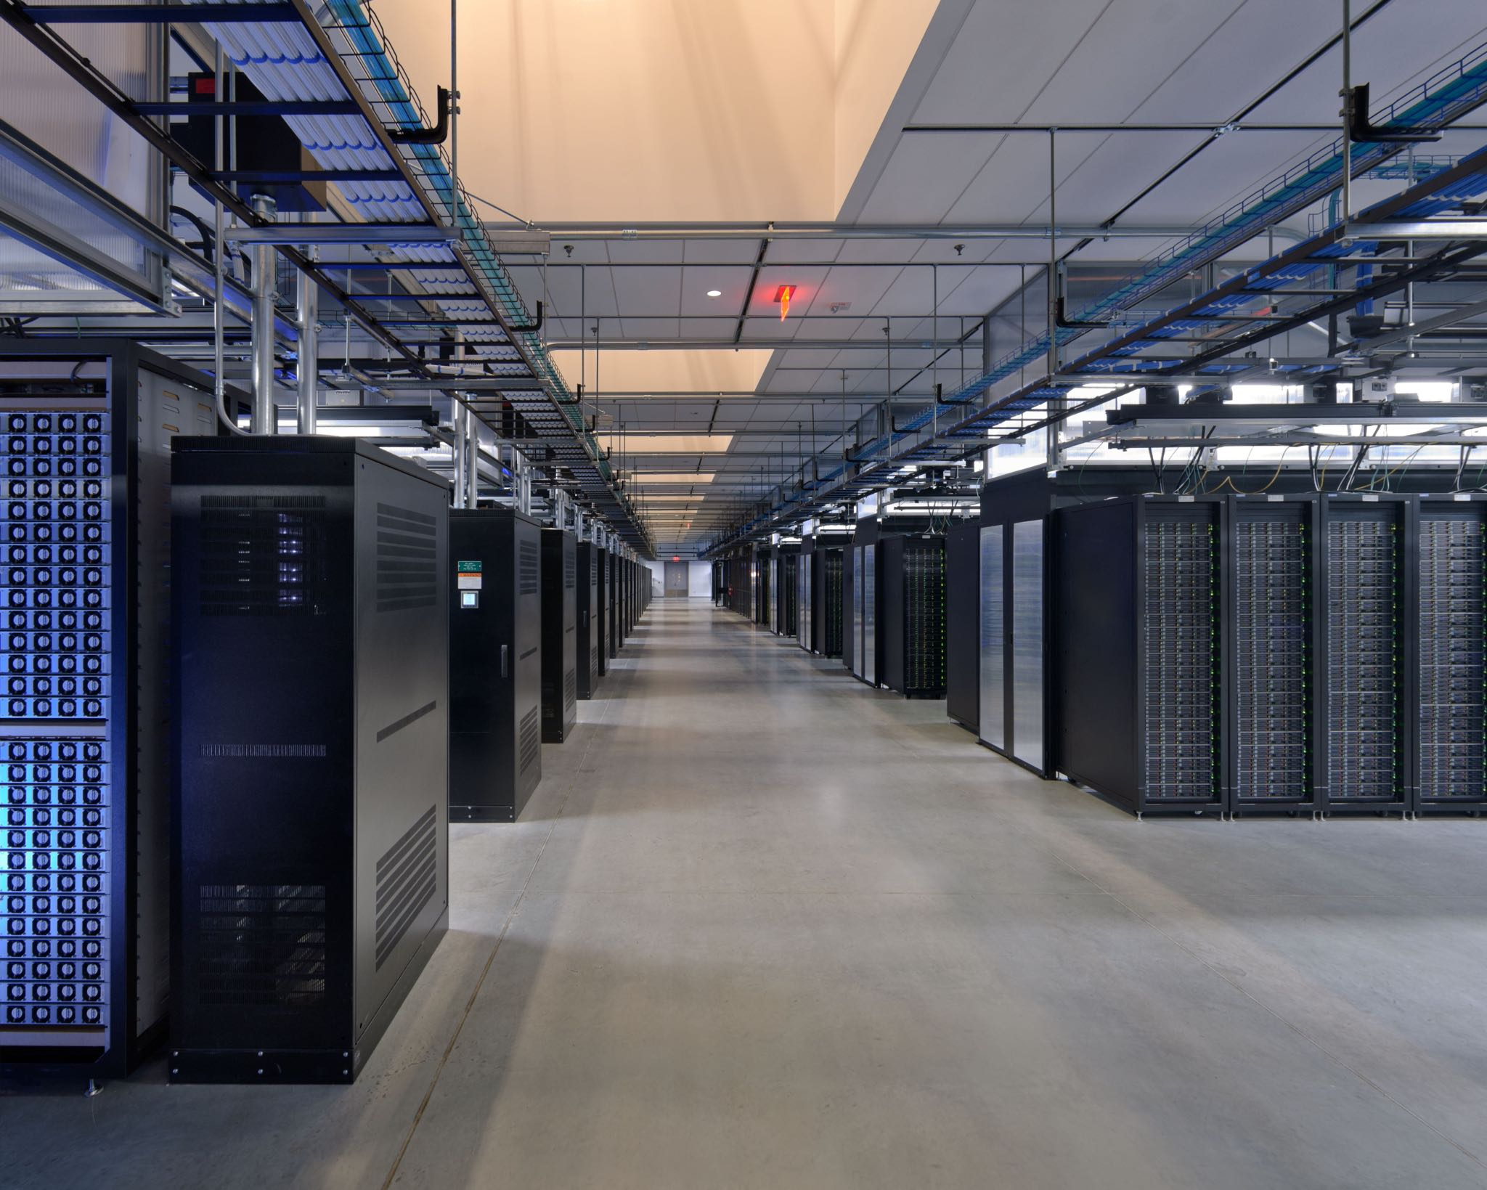
Anatomy of a Data Center
Cloud Computing Service Models
Commodity CPU:
Xeon E5-2440: 6/12 cores Xeon Gold 6148: 20/40 cores
Server:
Multiple sockets, RAM, disks
Rack:
16-64 servers + top-of-rack switch
Data Center:
>100,000 servers
Cluster:
Multiple racks + cluster switch
[Google Data Center, Eemshaven, Netherlands]

Slide 11
Fault Tolerance
Cloud Computing Service Models
[Christos Kozyrakis and Matei Zaharia: CS349D: Cloud Computing Technology, lecture, Stanford 2018]
Yearly Data Center Failures
~0.5 overheating (power down most machines in <5 mins, ~1-2 days)
~1 PDU failure (~500-1000 machines suddenly disappear, ~6 hrs)
~1 rack-move (plenty of warning, ~500-1000 machines powered down, ~6 hrs)
~1 network rewiring (rolling ~5% of machines down over 2-day span)
~20 rack failures (40-80 machines instantly disappear, 1-6 hrs)
~5 racks go wonky (40-80 machines see 50% packet loss)
~8 network maintenances (~30-minute random connectivity losses)
~12 router reloads (takes out DNS and external vIPs for a couple minutes)
~3 router failures (immediately pull traffic for an hour)
~dozens of minor 30-second blips for dns
~1000 individual machine failures (2-4% failure rate, at least twice)
~thousands of hard drive failures (1-5% of all disks will die)

Slide 12
Fault Tolerance, cont.
Cloud Computing Service Models
Other Common Issues
Configuration issues, partial SW updates, SW bugs
Transient errors: no space left on device, memory corruption, stragglers
Recap: Error Rates at Scale
Cost-effective commodity hardware
Error rate increases with increasing scale
Fault Tolerance for distributed/cloud storage and data analysis
➔ Cost-effective Fault Tolerance
BASE (basically available, soft state, eventual consistency)
Effective techniques
ECC (error correction codes), CRC (cyclic redundancy check) for detection
Resilient storage: replication/erasure coding, checkpointing, and lineage
Resilient compute: task re-execution / speculative execution
Notes:
stragglers are computing nodes or workers that lag behind others in completing a task. In parallel processing systems, tasks are often divided among multiple nodes to speed up the overall computation. Stragglers can significantly slow down the completion of the entire task because the system is only as fast as its slowest component.

Slide 13
Virtualization
Cloud Computing Service Models
Applications
#1 Native Virtualization
Simulates most of the HW interface
Unmodified guest OS to run in isolation
Examples: VMWare, Parallels, AMI (HVM)
#2 Para Virtualization
No HW interface simulation, but special API (hypercalls)
Requires modified guest OS to use hyper calls, trapped by hypervisor
Examples: Xen, KVM, Hyper-V, AMI (PV)
#3 OS-level Virtualization
OS allows multiple secure virtual servers
Guest OS appears isolated but same as host OS
Examples: Solaris/Linux containers, Docker
#4 Application-level Virtualization
Examples: Java VM (JVM), Ethereum VM (EVM), Python virtualenv
Libraries
Operating System
Hardware
[Prashant Shenoy: Distributed and Operating Systems - Module 1: Virtualization, UMass Amherst, 2019]
Notes:
Note: AMI (Amazon Machine Image) runs on Xen

Slide 14
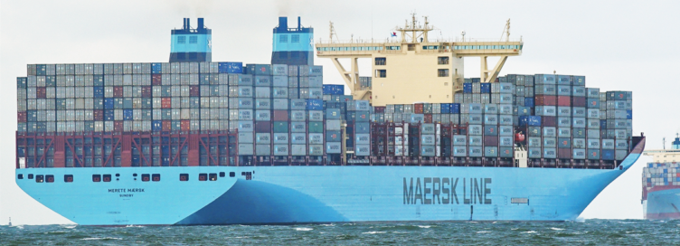




Containerization
Cloud Computing Service Models
Docker Containers
Shipping container analogy
Arbitrary, self-contained goods, standardized units
Containers reduced loading times ➔ efficient international trade
#1 Self-contained package of necessary SW and data (read-only image)
#2 Lightweight virtualization w/ shared OS and resource isolation via cgroups
Cluster Schedulers (see Lecture 09)
Container orchestration: scheduling, deployment, and management
Resource negotiation with clients
Typical resource bundles (CPU, memory, device)
Examples: Kubernetes, Mesos, (YARN), Amazon ECS, Microsoft ACS, Docker Swarm
[Brendan Burns, Brian Grant, David Oppen-heimer, Eric Brewer, John Wilkes: Borg, Omega, and Kubernetes. CACM 2016]
➔ from machine- to application-oriented scheduling

Slide 15
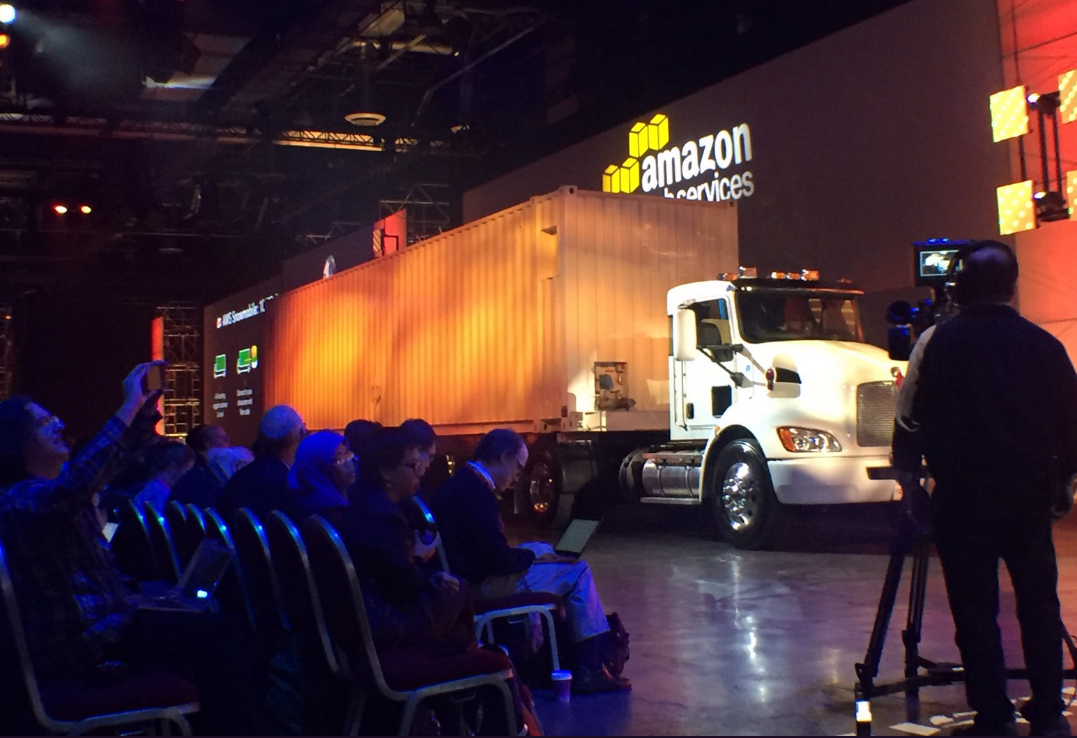
Excursus: AWS Snowmobile (since 2016)
Cloud Computing Service Models
Snowmobile Service: Data transfer on-premise → cloud via 100PB trucks
Real-World “Containerization” ☺
100PB ~26 years (1Gb Link)
→ weeks
[https://aws.amazon.com/snowmobile/?nc1=h_ls]

Slide 16
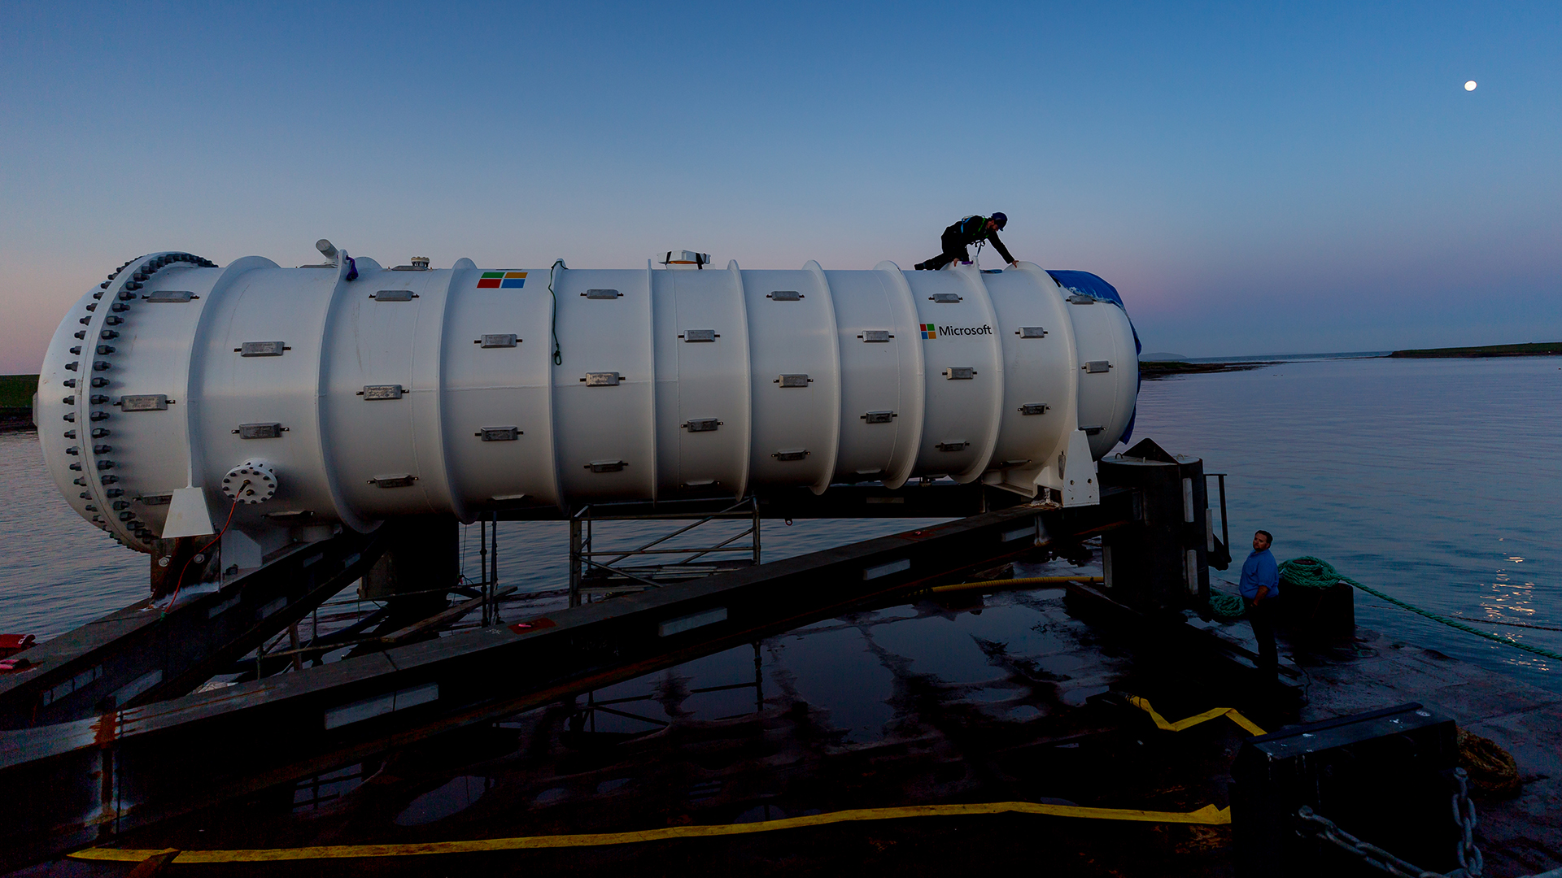
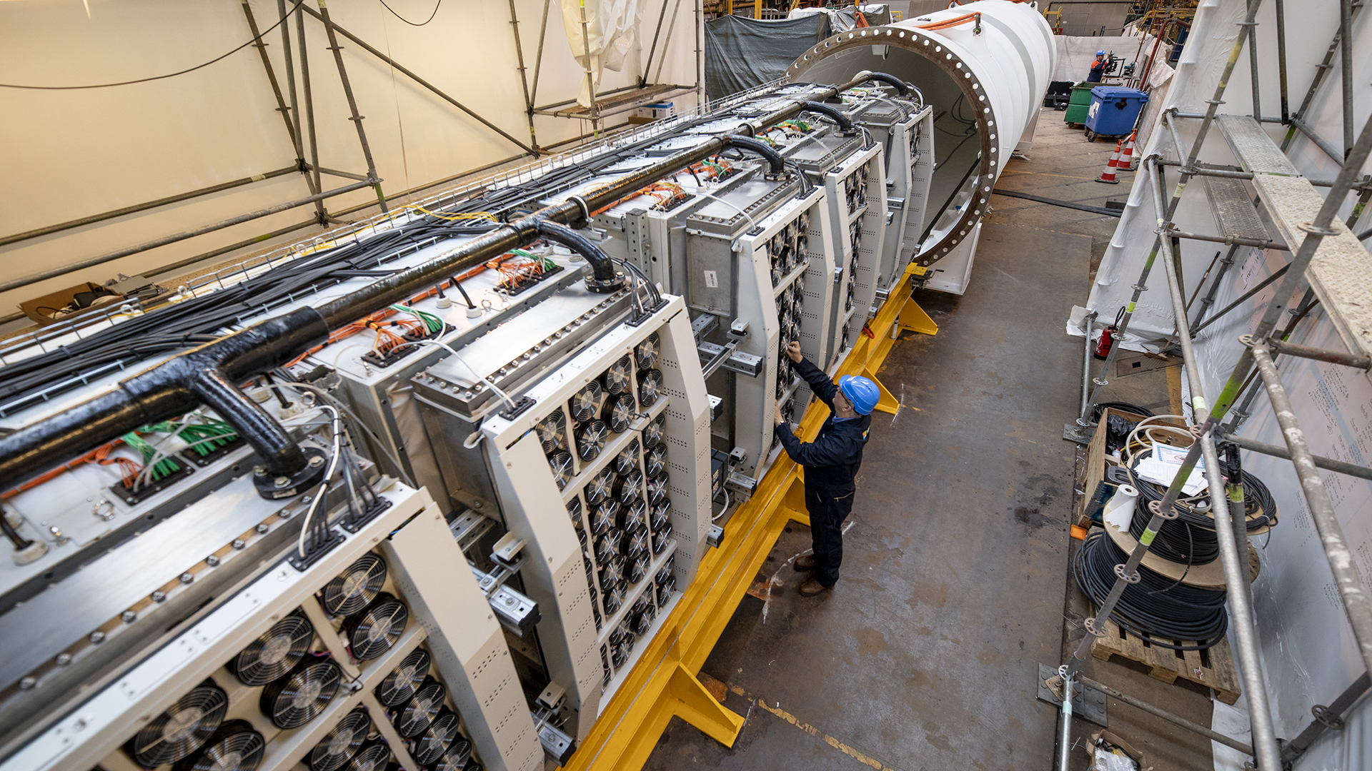
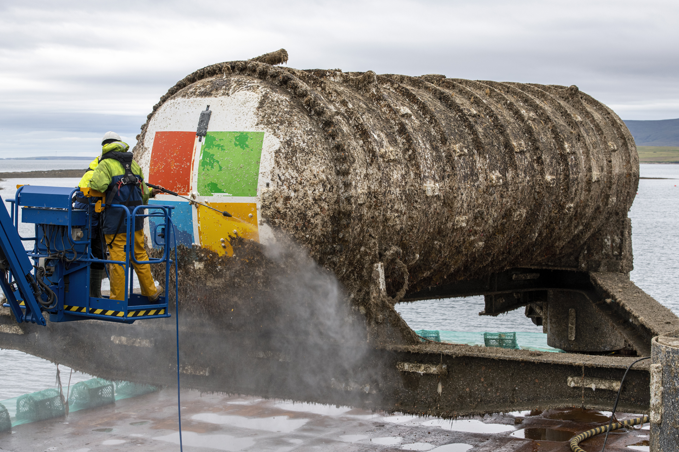
Excursus: Microsoft Underwater Datacenter
Cloud Computing Service Models
Study for feasibility, and if logistically, environmentally, economically practical
[https://news.microsoft.com/features/under-the-sea-microsoft-tests-a-datacenter-thats-quick-to-deploy-could-provide-internet-connectivity-for-years/, 06/2018]
[https://news.microsoft.com/innovation-stories/project-natick-underwater-datacenter/, 09/2020]
Notes:
Microsoft’s Project Natick team deployed the Northern Isles datacenter 117 feet deep to the seafloor in spring 2018

Slide 17
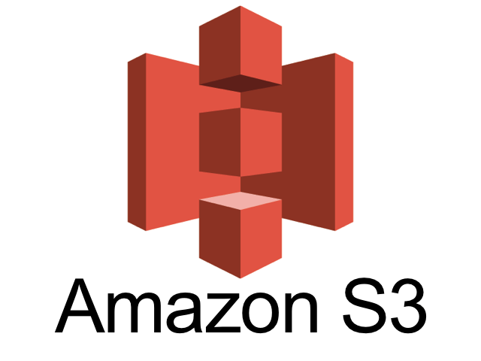
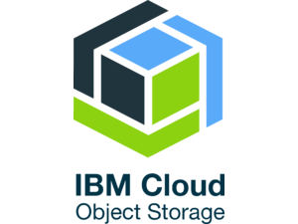
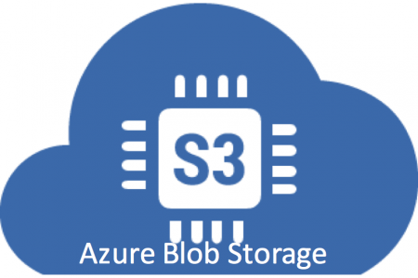
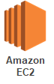
Infrastructure as a Service (IaaS)
Cloud Computing Service Models
Overview
Resources for compute, storage, networking as a service ➔ Virtualization as key enabler (simplicity and auto-scaling)
Target user: sys admin / developer
Storage
Amazon AWS Simple Storage Service (S3)
OpenStack Object Storage (Swift)
IBM Cloud Object Storage
Microsoft Azure Blob Storage
Compute
Amazon AWS Elastic Compute Cloud (EC2)
Microsoft Azure Virtual Machines (VM)
IBM Cloud Compute

Slide 18
Infrastructure as a Service (IaaS), cont.
Cloud Computing Service Models
Example AWS Setup
Create user and security credentials
Example AWS S3 File Upload
Setup and configure S3 bucket
WebUI or cmd for interactions
Example AWS EC2 Instance Lifecycle
> aws2 configure
AWS Access Key ID [None]: XXX
AWS Secret Access Key [None]: XXX
Default region name [None]: eu-central-1
Default output format [None]:
> aws2 s3 cp data s3://bucketname/air \ --recursive
> aws2 s3 ls s3://bucketname/air \ --recursive
2019-12-05 15:26:45 20097 air/Airlines.csv
2019-12-05 15:26:45 260784 air/Airports.csv
2019-12-05 15:26:45 6355 air/Planes.csv
2019-12-05 15:26:45 1001153 air/Routes.csv
> aws2 ec2 allocate-hosts \
--instance-type m4.large \
--availability-zone eu-central-1a \
--quantity 2
Notes:
Notes: eu-central-1 → Frankfurt

Slide 19
Platform as a Service (PaaS)
Cloud Computing Service Models
Overview
Provide environment setup (libraries, configuration), platforms, and services to specific applications ➔ additional charges
Target user: developer
Example AWS Elastic MapReduce (EMR)
Environment for Apache Hadoop, MapReduce, and Spark over S3 data, incl entire eco system of tools and libraries
> clusterId=$(aws emr create-cluster --applications Name=Spark \
--ec2-attributes ... --instance-type m4.large --instance-count 100 \
--steps '[{"Args":["spark-submit","--master","yarn",'${sparkParams}'"--class", \
"org.tugraz.sysds.api.DMLScript","./SystemDS.jar","-f","./test.dml"], ...]' \
--scale-down-behavior TERMINATE_AT_INSTANCE_HOUR --region eu-central-1)
> aws emr wait cluster-running --cluster-id $clusterId
> aws emr wait cluster-terminated --cluster-id $clusterId

Slide 20

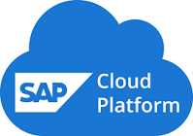
Software as a Service (SaaS)
Cloud Computing Service Models
Overview
Provide application as a service, often via simple web interfaces
Challenges/opportunities: multi-tenant systems (privacy, scalability, learning)
Target user: end users
Examples
Email/chat services: Google Mail (Gmail), Slack
Writing and authoring services: Microsoft Office 365, Overleaf
Enterprise: Salesforces, ERP as a service (SAP HANA Cloud)
Database as a Service (DaaS)
[Stefan Aulbach, Torsten Grust, Dean Jacobs, Alfons Kemper, Jan Rittinger: Multi-tenant databases for software as a service: schema-mapping techniques. SIGMOD 2008]

Slide 21
Software as a Service (SaaS)
Cloud Computing Service Models
Performance Analysis on Gmail Data
Coordinated bursty tracing via time
Vertical context injection into kernel logs
[Dan Ardelean, Amer Diwan, Chandra Erdman: Performance Analysis of Cloud Applications. NSDI 2018]
EU/US
(validate, update, repair, compact)
(a) Variations in rate and mix of user visible requests (UVR)
4x lightning Belgium DC → reconstruct
(b) Variations in rate and mix of essential non-UVR work
(c) Variations due to one-off events
Notes:
Note: TU Graz email SMTP due to database backup schedule

Slide 22



Serverless Computing (FaaS)
Cloud Computing Service Models
Definition Serverless
FaaS: functions-as-a-service (event-driven, stateless input-output mapping)
Infrastructure for deployment and auto-scaling of APIs/functions
Examples: Amazon Lambda, Microsoft Azure Functions, etc
Example
Lambda Functions
Event Source (e.g., cloud services)
Other APIs and Services
Auto scaling Pay-per-request (1M x 100ms = 0.2$)
import com.amazonaws.services.lambda.runtime.Context;
import com.amazonaws.services.lambda.runtime.RequestHandler;
public class MyHandler implements RequestHandler<Tuple, MyResponse> {
@Override
public MyResponse handleRequest(Tuple input, Context context) {
return expensiveStatelessComputation(input);
}
}
Notes:
Note: lambda calculus

Slide 23
Serverless Computing (FaaS), cont.
Cloud Computing Service Models
Advantages (One Step Forward)
Auto-scaling (the workload drives the allocation and deallocation of resources)
Use cases: embarrassingly parallel functions, orchestration functions (of proprietary auto scaling services), function composition (workflows)
Disadvantages (Two Steps Backward)
Lacks efficient data processing (limited lifetime of state/caches, I/O bottlenecks due to lack of co-location)
Hinders distributed systems development (communication through slow storage, no specialized hardware)
[Joseph M. Hellerstein et al: Serverless Computing: One Step Forward, Two Steps Back. CIDR 2019]
➔ “Taken together, these challenges seem both interesting and sur-mountable. [...] Whether we call the new results ‘serverless computing’ or something else, the future is fluid.”

Slide 24
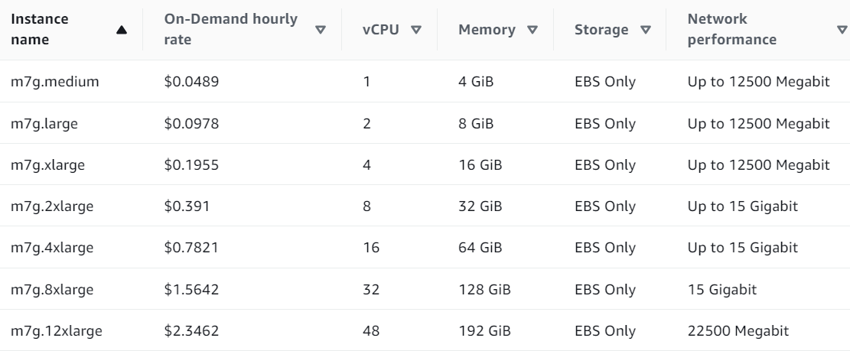
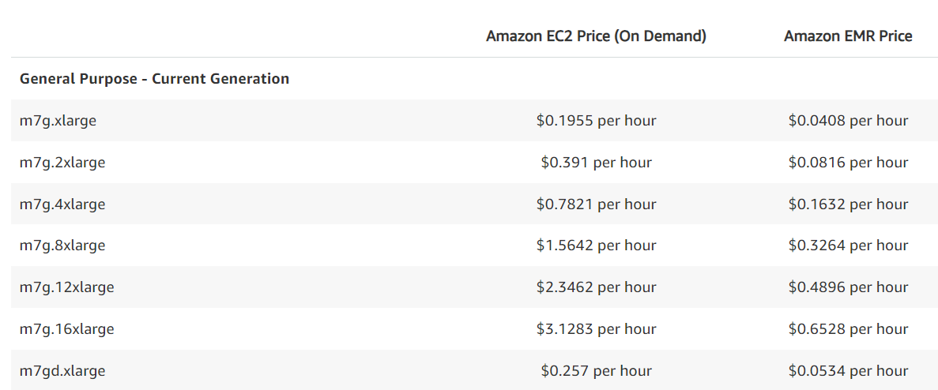
Example AWS Pricing (current gen)
Cloud Computing Service Models
as of 11/2023
Amazon EC2 (Elastic Compute Cloud)
IaaS offering of different node types and generations
On-demand, reserved, and spot instances
Amazon ECS (Elastic Container Service)
PaaS offering for Docker containers
Automatic setup of Docker environment
Amazon EMR (Elastic Map Reduce)
PaaS offering for Hadoop workloads
Automatic setup of YARN, HDFS, and specialized frameworks like Spark
Prices in addition to EC2 prices
Pricing according to EC2 (on-Demand)
Notes:
Note: scale-out cheaper than scale-up; pricing granularity: hour or second (depending on instance type, min 60 seconds if second granularity)

Slide 25
Cloud, Fog, and Edge Computing

Slide 26
Cloud vs Fog vs Edge Overview
Cloud, Fog, and Edge Computing
Overview Edge Computing
Huge number of mobile / IoT devices
Edge computing for latency, bandwidth, privacy
Fog & Edge Computing
Different degrees of application decentralization
Reasons: energy, performance, data
Natural hierarchy, heterogeneity
Cloud as enabler for vibrant web ecosystem
→ fog/edge for IoT the same?
[Maria Gorlatova: Special Topics: Edge Computing; IoT Meets the Cloud – The Origins of Edge Computing, Duke University 2018]

Slide 27
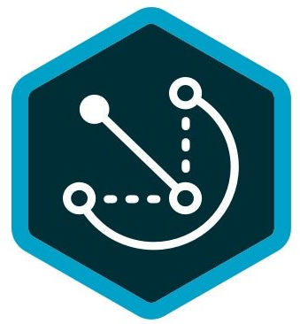
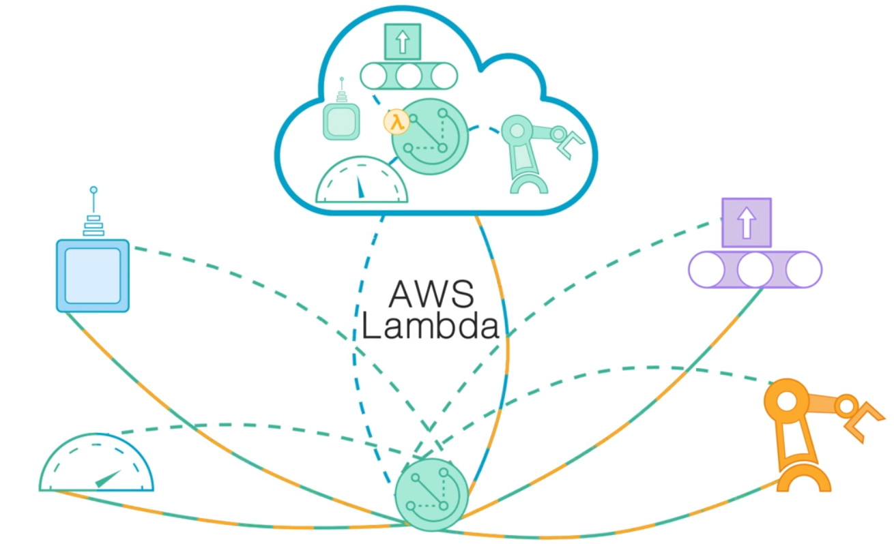
Example: AWS Greengrass
Cloud, Fog, and Edge Computing
[Credit: https://aws.amazon.com/ greengrass/?nc1=h_ls]
Overview AWS Greengrass
Combine cloud computing and groups of IoT devices
Cloud configuration, group cores, connected devices to groups
Run lambda functions (FaaS) in cloud, fog, and edge – partial autonomy
System Architecture
Central configuration and deployment
Decentralized operation
Customer Use cases: “My data doesn’t reach the cloud”
Notes:
Note: Azure Stack similar in spirit

Slide 28

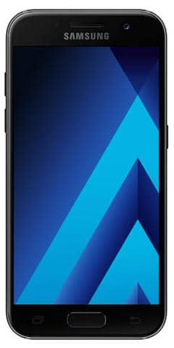


Federated ML
Cloud, Fog, and Edge Computing
[Keith Bonawitz et al.: Towards Federated Learning at Scale: System Design. SysML 2019]
Overview Federated ML
Learn model w/o central data consolidation
Privacy vs personalization and sharing (example application: voice recognition)
Adaptation of parameter server architecture, w/ random client sampling and distributed agg.
Training when phone idle, charging, and on WiFi
Example Data Ownership
Thought experiment: B uses machine from A to test C’s equipment.
Who owns the data?
Negotiated in bilateral contracts
Spectrum of Data Ownership: Federated learning might create new markets
W
ΔW
D1
D2
D3
XXXXXXXX XXXXXXXXXXXXXXXXXXXXXXX
XXXXXXXX
XXXXX
Machine Vendor A
Middle Person B
Customer C
Notes:
Note: training on edge, distributed agg in fog

Slide 29
Spectrum of Data Sharing
Cloud, Fog, and Edge Computing
Fine-grained Spectrum
Spectrum of technologies with performance/privacy/utility tradeoffs
Different applications with different requirements
Potential: New markets for data-driven services in this spectrum
Increasing Utility/Perf
Increasing Privacy
Private Data (no sharing)
Privacy- enhancing Technologies (FHE, MPC, Differential Privacy)
Aggregates (Federated ML, Federated w/ secure comm.)
Anonymized Data (k-anonymity, pseudonyms)
Surrogate Data (Characteristics-preserving synthetic data)
Public Data (full sharing, sharing w/ partners)
Key Property: no reconstruction of private raw data
Notes:
Note: Delta Sharing: An Open Protocol for Secure Data Sharing, Databricks 2021
https://databricks.com/de/blog/2021/05/26/introducing-delta-sharing-an-open-protocol-for-secure-data-sharing.html

Slide 30
Summary and Q&A
Cloud Computing Motivation and Terminology
Cloud Computing Service Models
Cloud, Fog, and Edge Computing
Next Lectures
08 Cloud Resource Management and Scheduling [Dec 01]

